Slide 1
Recommender systems-part 2
Marziyeh Mousavi
Introduction to datascience
Fall 2024

Slide 2
User-Based Collaborative Filtering
To suggest new recommendations to a particular user, a group of similar users (nearest neighbors) is created based on the interactions of the reference user. The items that are most popular in this group, but new to the target user, are used for the suggestions.

Slide 3
User-Based Collaborative Filtering
User to user collaborative filtering basically operates under the assumption that users who gave similar ratings to a certain item are likely to have the same preference for other items as well. Therefore this method mainly relies on finding similarity between users.

Slide 4
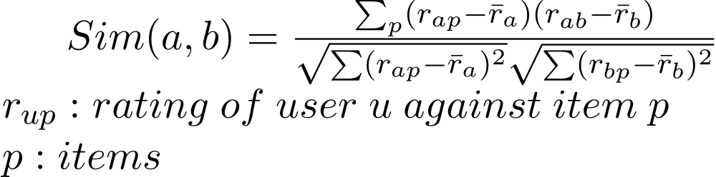
User-Based Collaborative Filtering-algorithm
Step 1: Finding the similarity of users to the target user U. Similarity for any two users ‘a’ and ‘b’ can be calculated from the given formula:

Slide 5
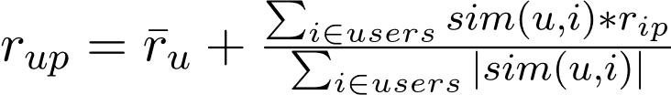
User-Based Collaborative Filtering-algorithm
Step 2:Prediction of missing rating of an item :Now, the target user might be very similar to some users and may not be much similar to others. Hence, the ratings given to a particular item by the more similar users should be given more weightage than those given by less similar users and so on. This problem can be solved by using a weighted average approach. In this approach, you multiply the rating of each user with a similarity factor calculated using the above mention formula. The missing rating can be calculated as

Slide 6
User-Based Collaborative Filtering-example
Consider a matrix that shows four users Alice, U1, U2 and U3 rating on different news apps. The rating range is from 1 to 5 on the basis of users’ likability of the news app. The ‘?’ indicates that the user has not rated the app.
Name | l1 | l2 | l3 | l4 | l5
alice | 5 | 4 | 1 | 4 | ?
u1 | 3 | 1 | 2 | 3 | 3
u2 | 4 | 3 | 4 | 3 | 5
u3 | 3 | 3 | 1 | 5 | 4
Image taken from geeks for geeks

Slide 7
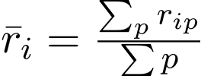
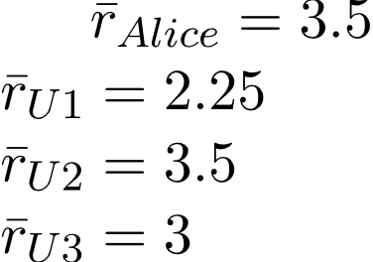
User-Based Collaborative Filtering-example
Step 1: Calculating the similarity between Alice and all the other users At first we calculate the averages of the ratings of all the user excluding I5 as it is not rated by Alice. Therefore, we calculate the average as
Therefore, we have

Slide 8

User-Based Collaborative Filtering-example
and calculate the new ratings as
Hence, we get the following matrix,
Name | l1 | l2 | l3 | l4 | l5
alice | 1.5 | 0.5 | -2.5 | 0.5 | Don’t care
u1 | 0.75 | -1.25 | -0.25 | 0.75 | Don’t care
u2 | 0.5 | -0.5 | 0.5 | -0.5 | Don’t care
u3 | 0 | 0 | -2 | 2 | Don’t care

Slide 9
User-Based Collaborative Filtering-example
Now, we calculate the similarity between Alice and all the other users.

Slide 10
Matrix Factorization
Matrix factorization is a powerful mathematical technique used in various fields, from recommendation systems to data compression. At its core, it’s a method for breaking down a complex matrix into simpler, more manageable components.

Slide 11
Matrix Factorization
Imagine you have a large dataset representing interactions between users and items. For instance, it could be user ratings for movies on a streaming platform. This data can be organized as a matrix, with users as rows and items as columns. The cells of the matrix contain the ratings.

Slide 12
Matrix Factorization
Matrix factorization is the process of decomposing this matrix into two or more matrices that, when multiplied together, approximate the original matrix. In simpler terms, it’s finding hidden patterns or features within the data.

Slide 13
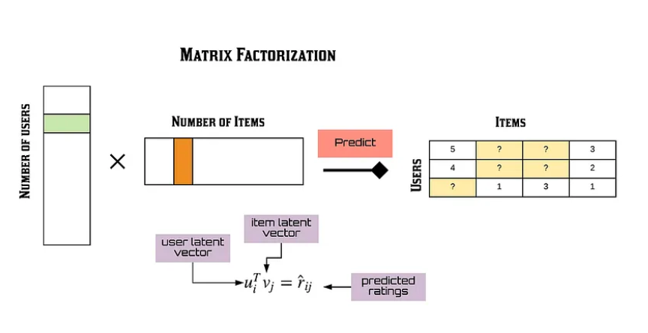
How Does Matrix Factorization Work?
The most common form of matrix factorization is Singular Value Decomposition (SVD). It involves breaking down the original matrix into three matrices:

Slide 14
How Does Matrix Factorization Work?
U (Left Singular Vectors): This matrix represents the relationships between users and latent features. Each row corresponds to a user, and each column corresponds to a feature.

Slide 15
How Does Matrix Factorization Work?
Σ (Singular Values): This is a diagonal matrix that contains information about the importance of each latent feature. The values are arranged in descending order, indicating the significance of each feature.

Slide 16
How Does Matrix Factorization Work?
Vᵀ (Right Singular Vectors): This matrix encodes the relationships between items and latent features. Each row corresponds to a feature, and each column corresponds to an item.

Slide 17
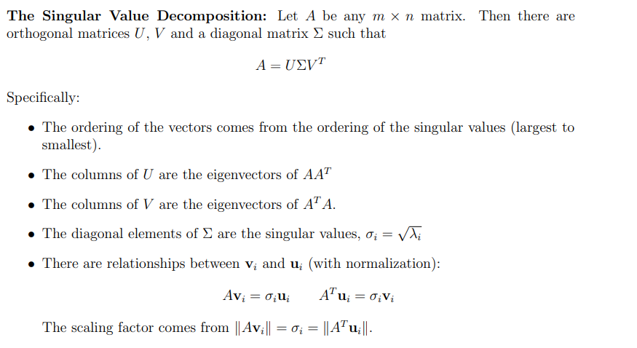
SVD-formula

Slide 18
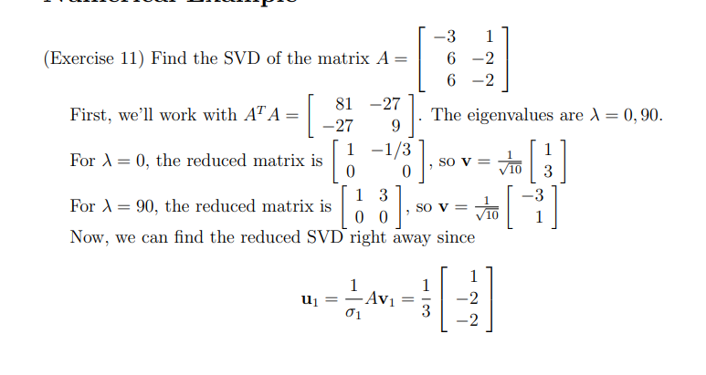
SVD-example

Slide 19
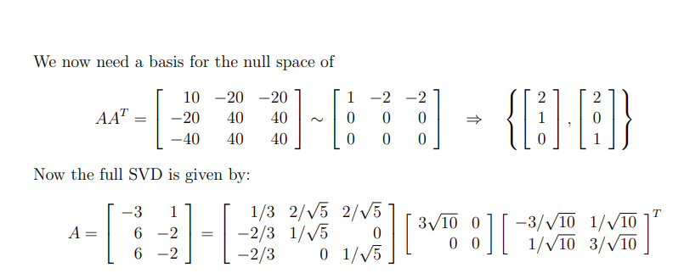
SVD-example

Slide 20
Surprise
Surprise is one of the “scikit-based Python” libraries to develop recommender systems using explicit rating data. Since Surprise is one of scikit-based libraries, it is relatively easy to use for developers that are quite familiar using scikit-based libraries, such as scikit-learn. Conveniently, Surprise provides several algorithms to develop collaborative filtering recommender systems, starting from memory-based method (i.e. K-Nearest Neighbors or KNN) to model-based method (i.e. Singular Value Decomposition or SVD).

Slide 21
Surprise
Surprise is one of the “scikit-based Python” libraries to develop recommender systems using explicit rating data. Since Surprise is one of scikit-based libraries, it is relatively easy to use for developers that are quite familiar using scikit-based libraries, such as scikit-learn. Conveniently, Surprise provides several algorithms to develop collaborative filtering recommender systems, starting from memory-based method (i.e. K-Nearest Neighbors or KNN) to model-based method (i.e. Singular Value Decomposition or SVD).

Slide 22
Surprise
Surprise is one of the “scikit-based Python” libraries to develop recommender systems using explicit rating data. Since Surprise is one of scikit-based libraries, it is relatively easy to use for developers that are quite familiar using scikit-based libraries, such as scikit-learn. Conveniently, Surprise provides several algorithms to develop collaborative filtering recommender systems, starting from memory-based method (i.e. K-Nearest Neighbors or KNN) to model-based method (i.e. Singular Value Decomposition or SVD).

Slide 23
SVD implementation using Surprise
First we read the dataset

Slide 24
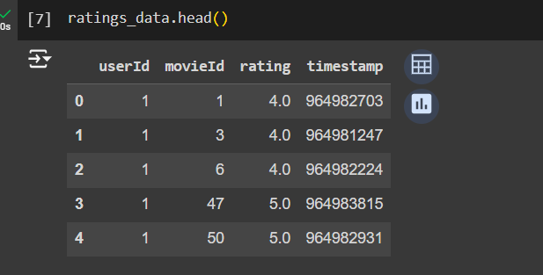
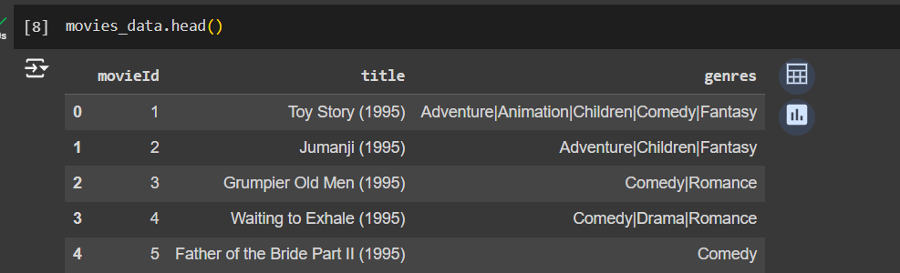
SVD implementation using Surprise
Our datasets are like this

Slide 25
SVD implementation using Surprise
The Reader class is used to parse a file containing ratings.Such a file is assumed to specify only one rating per line, and each line needs to respect the following structure:
user ; item ; rating ; [timestamp]
Dataset.load_from_file:Load a dataset from a (custom) file.

Slide 26
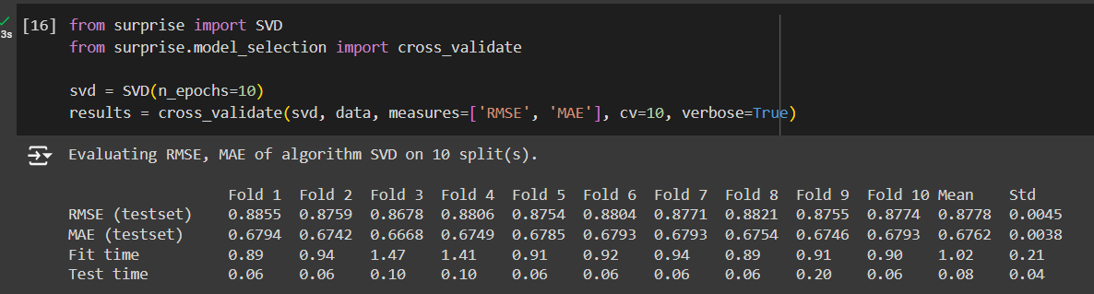
SVD implementation using Surprise
We use svd to train model and them we use cross validation

Slide 27
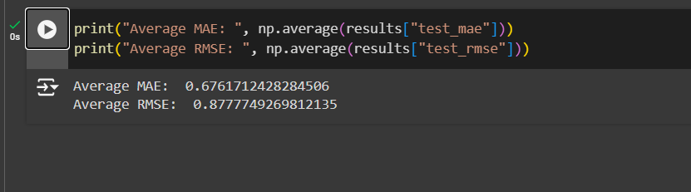
SVD implementation using Surprise
This is our losses

Slide 28
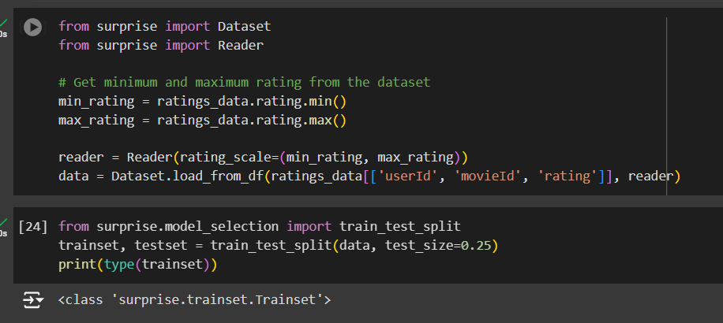
User based and item based collaborative filtering using surprise
Like last example we make our dataset. Then we split it in two dataset

Slide 29
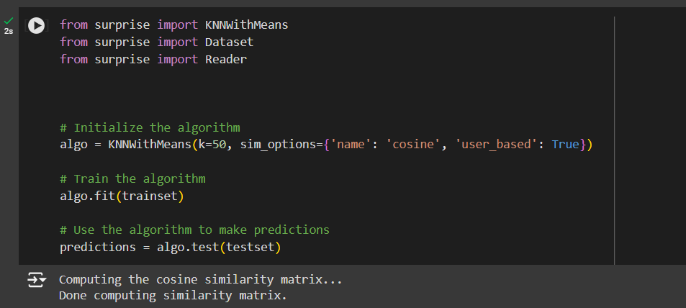
User based and item based collaborative filtering using surprise
We use cosine similarity as our measurement and we make the algorithm user based. We train the model, Then for testing we predict the ratings.
If we set user_based False,then the algorithm is item based.
Why knn? because knn is based on how similar two objects are and this is our purpose here.

Slide 30
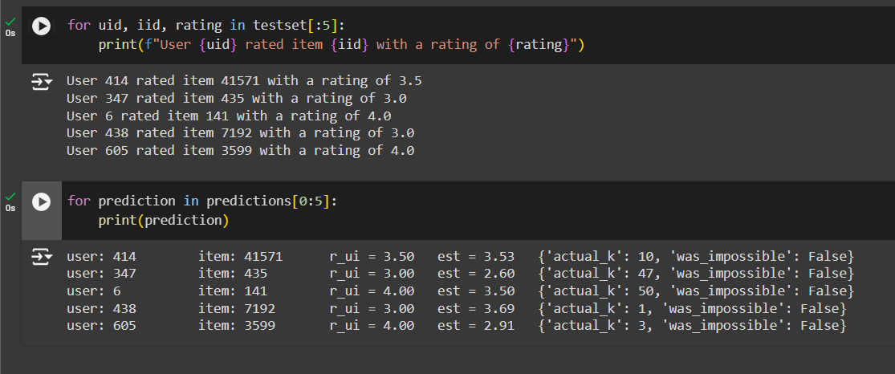
User based and item based collaborative filtering using surprise
For evaluating our model we print a part of prediction and test set.

